Slide 1
BIG DATA ADVANCED
Data Science Program

Slide 2
What’s Big Data
1
An introduction to big data world

Slide 3
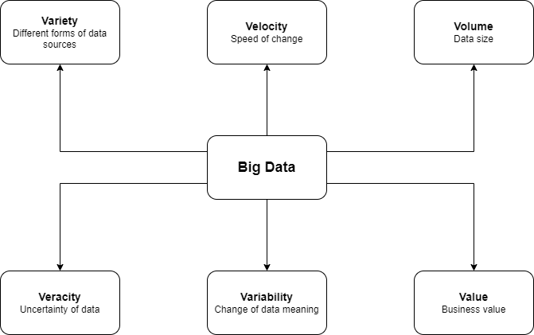
Big Data refers to the dynamic, large and disparate volumes of data being created by people, tools and machines. It requires new, innovative, and scalable technology to collect, host and analytically process the vast amount of data gathered in order to derive real-time business insights that relate to consumers, risk, profit, performance, productivity management and enhanced shareholder value.

Slide 4
The 6 Vs of Big Data
Variety
Data can be obtained from several sources, such as sensors, tweets, transactions, sales, and marketing. The data format is both structured and unstructured as well. Data types can also be different, binary, text, and JSON.
Velocity
Velocity refers to the increasing speed at which this data is created, and the increasing speed at which the data can be processed, stored, and analyzed.
Veracity
Data can be analyzed for actionable insights, but with so much data of all types being analyzed from across data sources, it is very difficult to ensure correctness and proof of accuracy.
Volume
Volume refers to the scale of the data, which is part of what makes big data big.
Value
Big data is large and is increasing everyday, however the data is also messy, noisy, and constantly changing.
Variability
Variability refers to data whose meaning is constantly changing.

Slide 5
Why is Big Data important
2
The benefits and advantages of big data

Slide 6
Risk Management
Banking company, uses Big Data analytics to identify fraudulent activities and discrepancies. The organization leverages it to narrow down a list of suspects or root causes of problems.
Cost Reduction
Big data technologies such as Hadoop and cloud-based analytics bring significant cost advantages when it comes to storing large amounts of data.
Quicker and Better Decision Making Within Organizations
Brands use Big Data analytics to make strategic decisions. For example, the company leverages it to decide if a particular location would be suitable for a new outlet or not. They will analyze several different factors, such as population, demographics, accessibility of the location, and more.

Slide 7
Improve Customer Experience
Customer service providers uses Big Data analysis to improve customer experiences. They monitor social media to find out their customers’ experience regarding their journeys, delays, and so on.
Product Development and Innovations
Manufacturers uses Big Data analytics to analyze how efficient the product designs are and if there is any need for improvements.

Slide 8
Big Data Open-source tools
3
Big Data open-source tools categorized

Slide 9
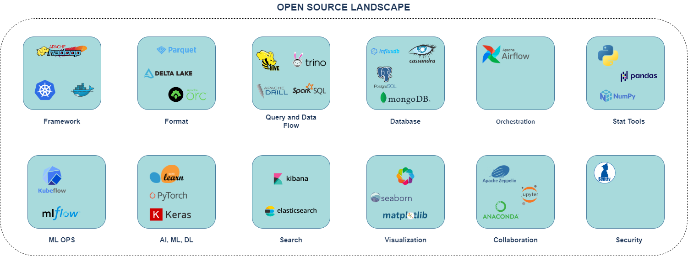

Slide 10


Frameworks
Apache Hadoop
The Apache Hadoop framework is an open-source software framework written in Java. The two main areas provided by the framework are storage and processing. For storage, the Apache Hadoop framework uses Hadoop Distributed File System (HDFS), which is based on the GFS paper released in October 2003. For processing or computing, the framework depends on MapReduce, which is based on a Google paper on MapReduce released in December 2004 MapReduce framework evolved from V1 (based on JobTracker and TaskTracker) to V2 (based on YARN).
Kubernetes
Kubernetes, also known as K8s, is an open-source system for automating deployment, scaling, and management of containerized applications. It groups containers that make up an application into logical units for easy management and discovery.

Slide 11
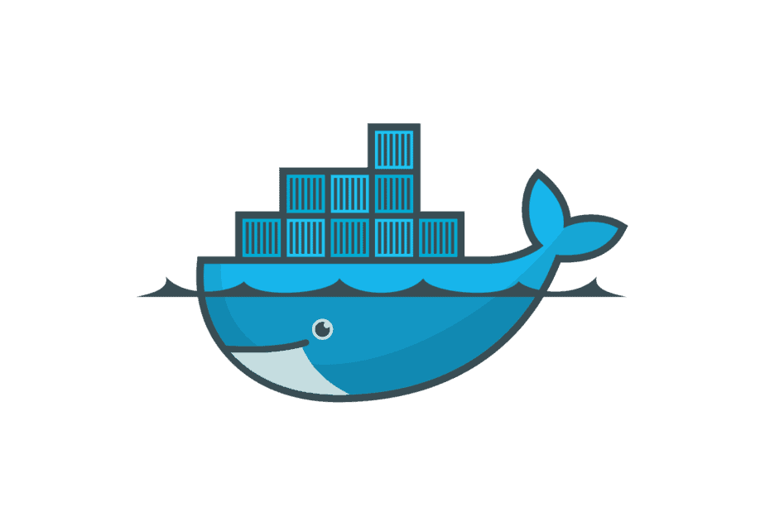
Frameworks
Docker
Docker is an open platform for developing, shipping, and running applications. Docker enables you to separate your applications from your infrastructure so you can deliver software quickly. It also provides the ability to package and run an application in a loosely isolated environment called a container. The isolation and security allows you to run many containers simultaneously on a given host. Containers are lightweight and contain everything needed to run the application, so you do not need to rely on what is currently installed on the host.

Slide 12


File Formats
Apache Parquet
Apache Parquet is an open source, column-oriented data file format designed for efficient data storage and retrieval. It provides efficient data compression and encoding schemes with enhanced performance to handle complex data in bulk. Apache Parquet is designed to be a common interchange format for both batch and interactive workloads.
Apache Orc
ORC is a self-describing type-aware columnar file format designed for Hadoop workloads. It is optimized for large streaming reads, but with integrated support for finding required rows quickly. Storing data in a columnar format lets the reader read, decompress, and process only the values that are required for the current query.

Slide 13

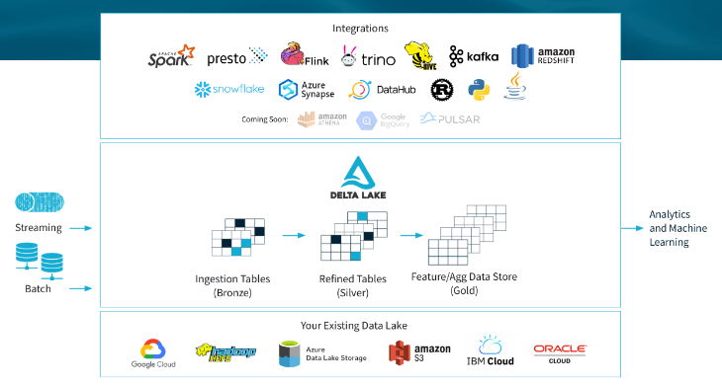
File Formats
Delta Lake
Delta Lake is an open-source storage framework that enables building a Lakehouse architecture with compute engines including Spark, PrestoDB, Flink, Trino, and Hive and APIs for Scala, Java, Rust, Ruby, and Python.

Slide 14



Query and Data Flow
Spark SQL
Spark SQL lets you query structured data inside Spark programs, using either SQL or a familiar DataFrame API. Usable in Java, Scala, Python and R.
Apache Hive
The Apache Hive data warehouse software facilitates reading, writing, and managing large datasets residing in distributed storage using SQL. Structure can be projected onto data already in storage. A command line tool and JDBC driver are provided to connect users to Hive.
Apache Drill
Drill is an Apache open-source SQL query engine for Big Data exploration. Drill is designed from the ground up to support high-performance analysis on the semi-structured and rapidly evolving data coming from modern Big Data applications, while still providing the familiarity and ecosystem of ANSI SQL, the industry-standard query language.

Slide 15


Query and Data Flow
Spark SQL
Spark SQL lets you query structured data inside Spark programs, using either SQL or a familiar DataFrame API. Usable in Java, Scala, Python and R.
Presto
Presto is an open-source SQL query engine that's fast, reliable, and efficient at scale. Use Presto to run interactive/ad hoc queries at sub-second performance for your high-volume apps. It eliminate the struggle with managing multiple query languages and interfaces to siloed databases and storage,
Trino
Trino is a tool designed to efficiently query vast amounts of data using distributed queries. If you work with terabytes or petabytes of data, you are likely using tools that interact with Hadoop and HDFS. Trino was designed as an alternative to tools that query HDFS using pipelines of MapReduce jobs, such as Hive or Pig, but Trino is not limited to accessing HDFS. Trino can be and has been extended to operate over different kinds of data sources, including traditional relational databases and other data sources such as Cassandra.

Slide 16
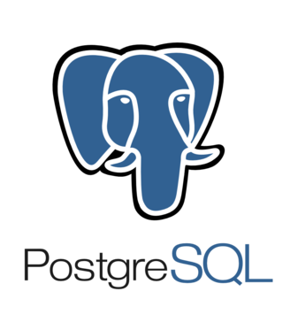


Databases
PostgreSQL
PostgreSQL is a powerful, open-source object-relational database system that uses and extends the SQL language combined with many features that safely store and scale the most complicated data workloads.
MongoDB
MongoDB is a source-available cross-platform document database. It stores data in a type of JSON format called BSON. If you are unfamiliar with JSON, a record in MongoDB is a document, which is a data structure composed of key value pairs similar to the structure of JSON objects.
Cassandra
Apache Cassandra is an open-source, NoSQL database (column-oriented) designed to store data for applications that require fast read and write performance. For example, you can use Cassandra to store user profile information for online video games, device metadata for internet of things (IoT) applications, or records for events.

Slide 17
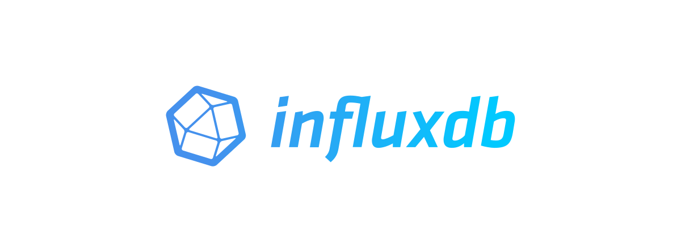

Databases
InfluxDB
InfluxDB is an open-source time series database (TSDB) developed by the company InfluxData. It is written in the Go programming language for storage and retrieval of time series data in fields such as operations monitoring, application metrics, Internet of Things sensor data, and real-time analytics.
Orchestration
Apache Airflow
Airflow is a platform that lets you build and run workflows. A workflow is represented as a DAG (a Directed Acyclic Graph), and contains individual pieces of work called Tasks, arranged with dependencies and data flows taken into account.

Slide 18

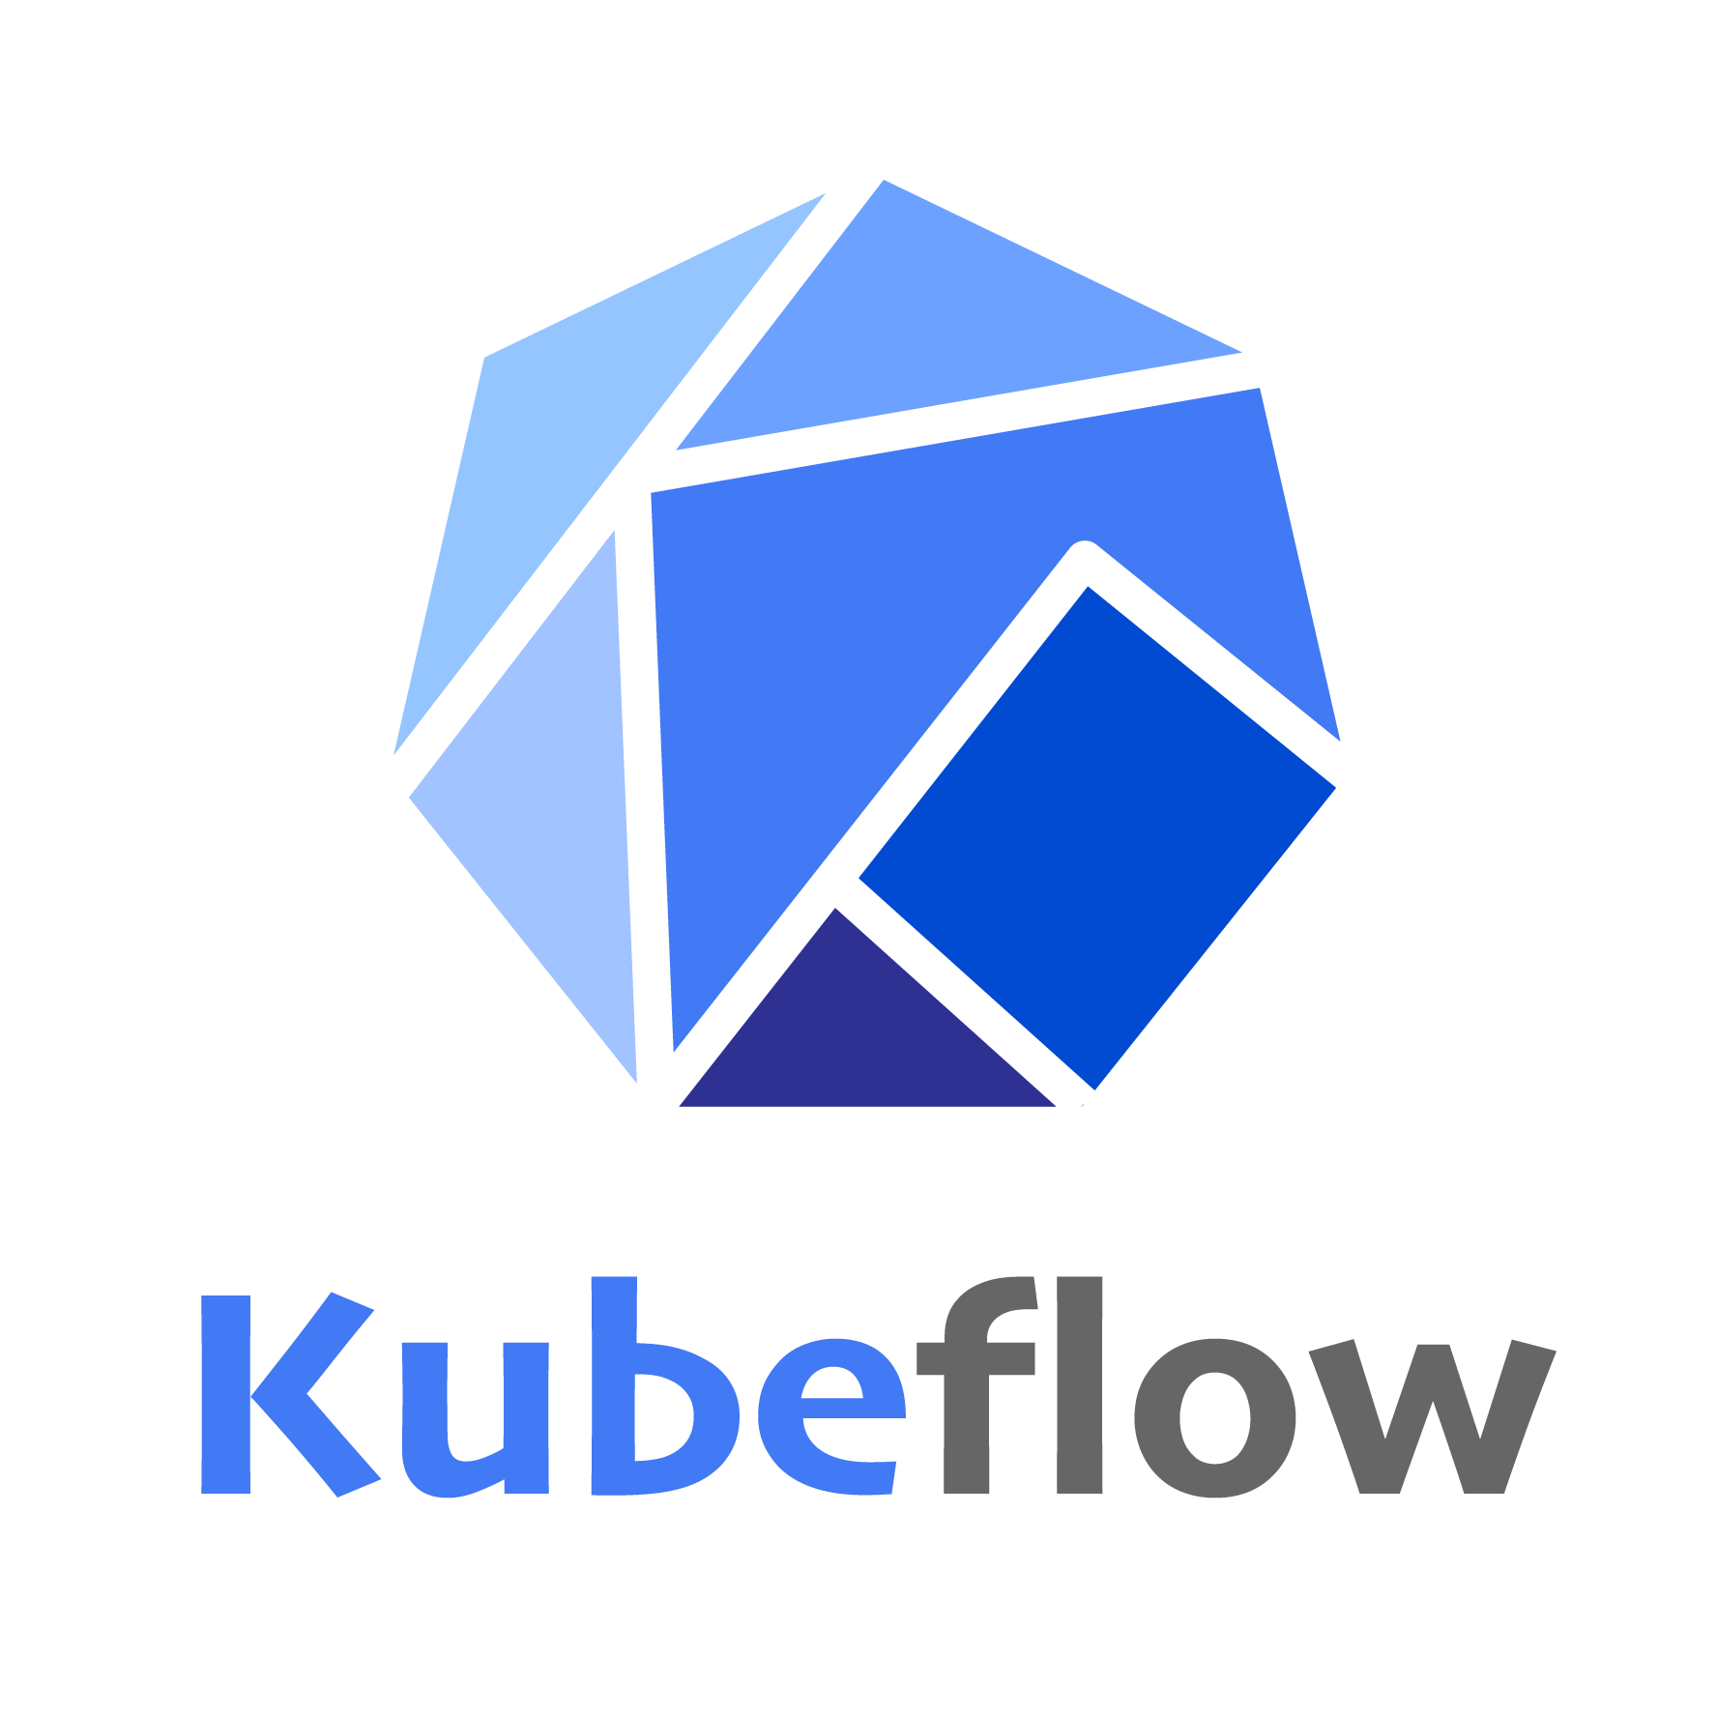
ML OPS
MLflow
MLflow is an open-source platform for managing the end-to-end machine learning lifecycle. It tackles four primary functions:
Tracking experiments to record and compare parameters and results (MLflow Tracking).
Packaging ML code in a reusable, reproducible form in order to share with other data scientists or transfer to production (MLflow Projects).
Managing and deploying models from a variety of ML libraries to a variety of model serving and inference platforms (MLflow Models). Providing a central model store to collaboratively manage the full lifecycle of an MLflow Model, including model versioning, stage transitions, and annotations (MLflow Model Registry).
Kubeflow
The Kubeflow project is dedicated to making deployments of machine learning (ML) workflows on Kubernetes simple, portable and scalable.

Slide 19



AI, ML, and Deep Learning
Keras
Keras is an API designed for human beings, not machines. Keras follows best practices for reducing cognitive load: it offers consistent & simple APIs, it minimizes the number of user actions required for common use cases, and it provides clear & actionable error messages.
PyTorch
PyTorch is a Python-based open-source machine learning framework scientific computing package serving two broad purposes:
A replacement for NumPy to use the power of GPUs and other accelerators.
An automatic differentiation library that is useful to implement neural networks.
Scikit-learn
Scikit-learn is an open-source ML library for Python. It features various classification, regression and clustering algorithms including support-vector machines, random forests, gradient boosting, k-means and DBSCAN

Slide 20

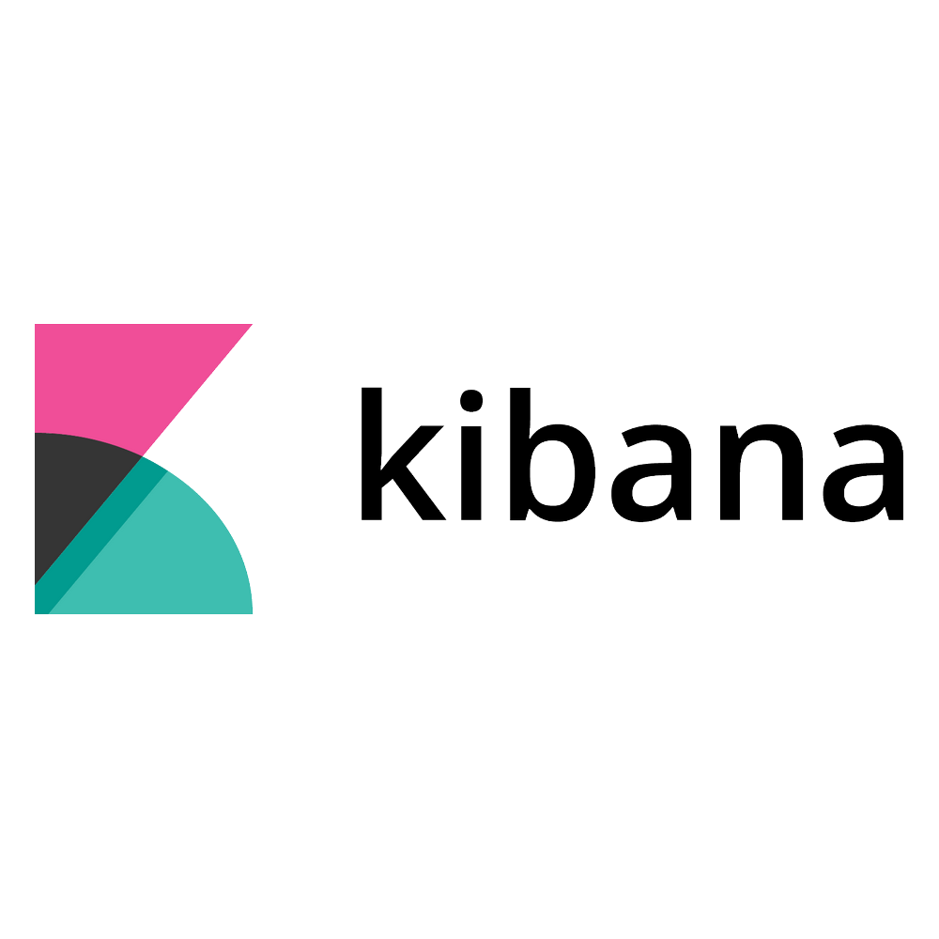
Search
Elasticsearch
Elasticsearch is a distributed, free and open search and analytics engine for all types of data, including textual, numerical, geospatial, structured, and unstructured. Known for its simple REST APIs, distributed nature, speed, and scalability, Elasticsearch is the central component of the Elastic Stack, a set of free and open tools for data ingestion, enrichment, storage, analysis, and visualization. Commonly referred to as the ELK Stack (after Elasticsearch, Logstash, and Kibana), the Elastic Stack now includes a rich collection of lightweight shipping agents known as Beats for sending data to Elasticsearch.
Kibana
Kibana is a free and open user interface that lets you visualize your Elasticsearch data and navigate the Elastic Stack. Do anything from tracking query load to understanding the way requests flow through your apps.

Slide 21



Visualization
Matplotlib
Matplotlib is a comprehensive library for creating static, animated, and interactive visualizations in Python. Matplotlib makes easy things easy and hard things possible.
Seaborn
Seaborn is a Python data visualization library based on matplotlib. It provides a high-level interface for drawing attractive and informative statistical graphics.
Bokeh
Bokeh is a Python library for creating interactive visualizations for modern web browsers. It helps you build beautiful graphics, ranging from simple plots to complex dashboards with streaming datasets. With Bokeh, you can create JavaScript-powered visualizations without writing any JavaScript yourself.

Slide 22



Collaboration
Anaconda
Anaconda offers the easiest way to perform Python/R data science and machine learning on a single machine. Start working with thousands of open-source packages and libraries today.
JupyterHub
JupyterHub is the best way to serve Jupyter notebook for multiple users. It can be used in a class of students, a corporate data science group or scientific research group. It is a multi-user Hub that spawns, manages, and proxies multiple instances of the single-user Jupyter notebook server.
Apache Zeppelin
Web-based notebook that enables data-driven, interactive data analytics and collaborative documents with SQL, Scala, Python, R and more.

Slide 23

Security
Apache Sentry
Apache Sentry™ is a system for enforcing fine grained role-based authorization to data and metadata stored on a Hadoop cluster.

